Slide 1
CALIBER 2020 Hackathon Submission
Team: CloudNimbus
Mohanlal, Chandrasekaran
Gurusamy, Balamurugan
Muthu Kumara Mani, S
Venkatesan, Prasanna
Sanmuganathan

Slide 2
Disclaimer
The information provided by AssitanceRequestApp of Team CloudNimbus is for general information purposes only. All information on the application is provided in good faith however we make no representation or warranty of any kind, express or implied, regarding the accuracy, adequacy, validity, reliability, availability or completeness of any information on the application.

Slide 3





Introduction of the Team with Pictures
Chandrasekaran
An adroit manager with over 15+ years of experience in Java frameworks
Balamurugan
A proficient technical architect with over 20+ years of experience in diverse technologies
Muthu Kumara Mani
An avid .NET programmer with over 12+ years of experience in Microsoft Technologies
Prasanna Venkatesan
An adept Java Web Developer with over 3+ years of experience in Spring MVC and J2EE
Sanmuganathan
A consummate .NET developer with over 6+ years of experience. Newbie to Microsoft Azure and curious about Cloud computing

Slide 4
VM Details & Instructions to execute code
VM Details
IP : 70.37.91.107
User Id : mkmanibose.s@gmail.com
Password : Mar@2020
NOTE: We didn't use VM machine boz we used .NET Core 3.1 where as Visual Studio 2017 installed in VM machine
How to Execute the Code (Steps)
Navigate to the following URL
https://assistancerequestapp.azurewebsites.net/
Click on the Home page to view the Dashboard page containing various request status and graph
Click on Request page to Create/View requests
Click on the Chat Icon to open chatbot
Type a query to get your clarifications addressed from the Azure chatbot
Source code in Github URL https://github.com/mkmanibose/AssistanceRequestApp
Open code in Visual Studio 2019 (boz .NET Core 3.1)
Check the SQL Server Database Connection
Run the application in Visual studio editor itself

Slide 5
Executive Summary
We have developed an automated chatbot that interacts with the user and gets the initial understanding about the requirements of the user.
Answers for elementary questions are fed in the chat bot. If the user’s condition is not met even after the initial answers provided by the chatbot, it automatically redirects the user to the ticket creation page wherein the user can create a ticket and get it resolved by a developer or support representative and track its closure.

Slide 6
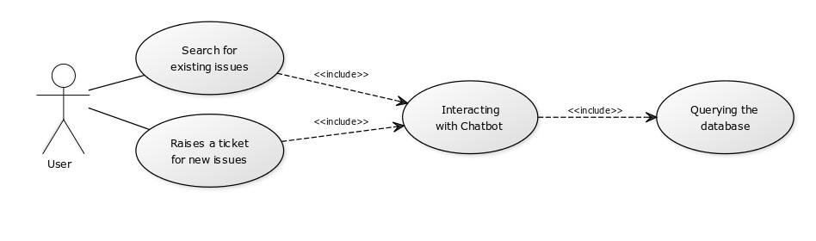
Use Case / Idea
Implementation of a Smart Chatbot that reduces the number of tickets created thereby minimizing the developer efforts in addressing basic queries posted by the user which enables the developer to concentrate on high priority issues.

Slide 7
What Problem are we Solving?
The nature of tickets in the Assistance Request portal is such that it spans over both basic issues as well as complicated issues.
The developer or support representative has to address both the type of requests.
The chatbot solution which we have currently developed saves greatly, the developer efforts by addressing the basic queries posted by the user. Only the complicated queries which are out of scope of the chatbot or which require manual intervention are addressed by the developer or support representative

Slide 8
Introduction to Solution
The user interacts with the chatbot instead of creating a ticket straightaway. The chatbot decides whether the user query requires human intervention or not
If the chatbot finds that the user query requires additional support, then it redirects the user to the ticket creation page where a user can log a ticket and get the query addressed.

Slide 9
What it does (detail it out)?
The ticket creation page contains a list of existing requests where the user can search for any similar issue
The answer for the user query is addressed based on the solutions from the previously closed tickets

Slide 10
Logical Architecture
Presentation Layer
Middle Layer
Cloud Layer
Azure ChatBot Services
CSS
ASP.NET
CORE 3.1
JQuery
Azure SQL Database
HTML
CORE BOT.NET
Azure Cognitive Services (QnA)
Bootstrap

Slide 11
Detailed Architecture Diagram
Azure Cloud Platform
Application
Insight
QnA Maker
Request
Gateway
Web Request
ChatBot Request
Azure
SQL DB
Chat Request
User
Web Request

Slide 12
Architecture Explanation
The Application receives both web requests and chat requests based on the filtering done from the user query
The Chatbot request which incorporates the Web Request from the user gets the Application Insights from QnA Maker which acts as the KnowledgeBase for basic user queries.
For other complex queries the chatbot interacts with the Azure DB through the request gateway and provides solutions to the user queries.

Slide 13
Assumptions
Below are the assumptions followed to fetch the answer for a query
The status of the previous ticket must be closed
Date completed must be a valid date
Resolution comments of the ticket mustn’t be empty
Related environment must have a valid value
Nature of request should match with the user criteria

Slide 14
Deployment Architecture Diagram
Azure Devops Code CheckIn
Build Triggered
Release Triggered
Azure Resources Updation/Creation
Deployed to App Services

Slide 15
Technical Details (Explain why you have chosen particular components in your architecture)
HTML – For design of basic skeleton
CSS/Bootstrap – Styling of the webpage
JQuery – DOM parsing and manipulation
ASP.NET Core – For developing the web application
Bot.Net – For utilizing Azure Bot Services
Azure Bot Services – Creating and Running Azure Bot
Azure SQL DB – For performing CRUD operations
Azure Cognitive Services – For giving decision making capabilities to the ChatBot

Slide 16
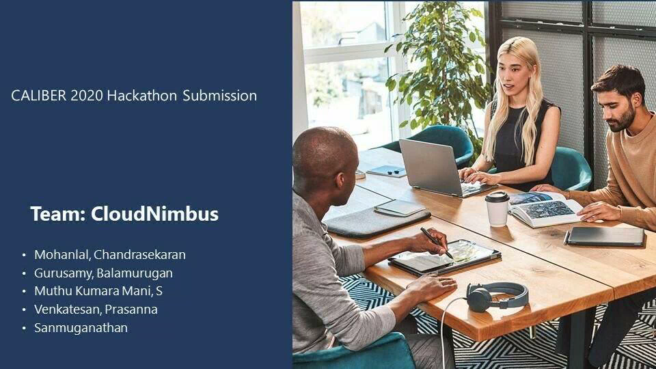
Demo Link and Demo File
Video, detailing the steps for using the application can be found on the below

Slide 17
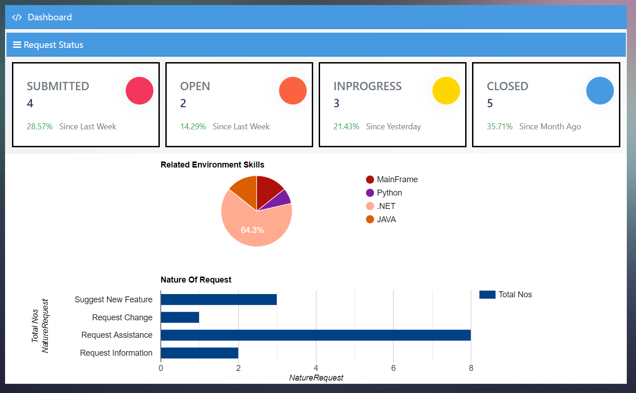
Sample Execution Flow – Home Page

Slide 18
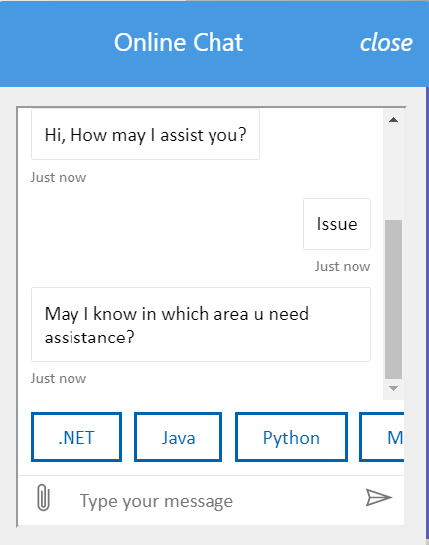
Sample Execution Flow – Chatbot Page

Slide 19
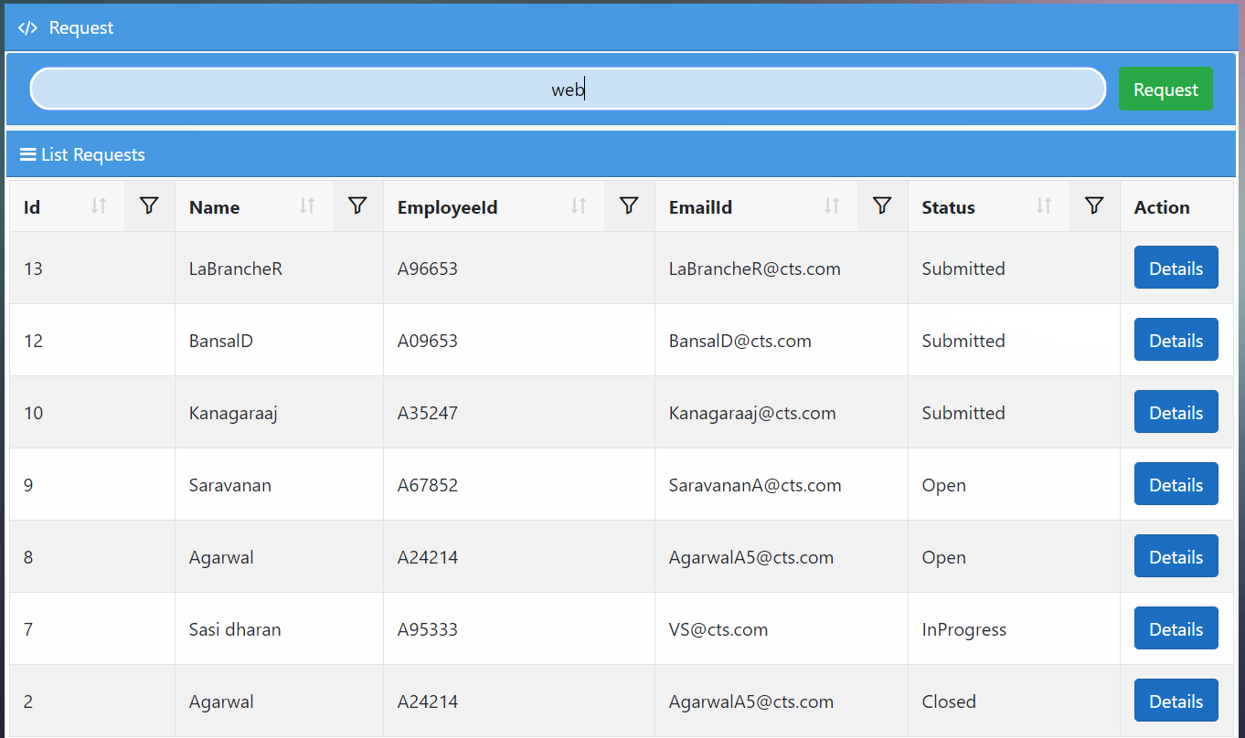
Sample Execution Flow – Requests Page with Filter Condition

Slide 20
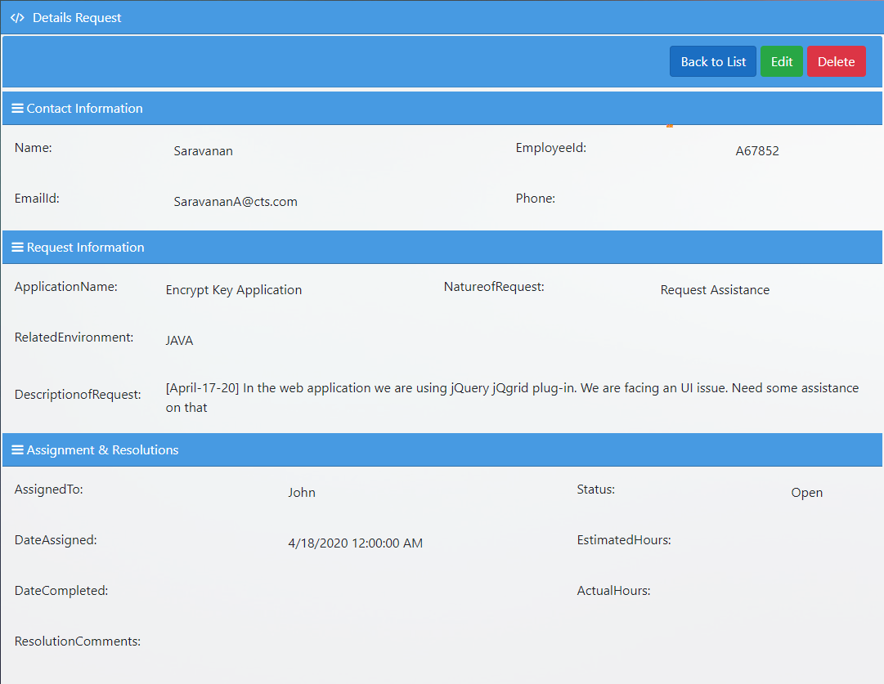
Sample Execution Flow – Request Detail Page

Slide 21
Next Steps / Future Roadmap
Resolution Comments Format output
File Upload Request
Email Trigger Request
Speech Recognition
Report Export in various file format (PDF, XLSX, CSV)
Automatic Request assignment to users
Enrichment of UI Design

Slide 22
Thank You

